Slide 1
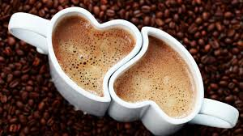
COFFEA CRUDA
Dr. P.R.SAIJI
ASSOCIATE PROFESSOR
DEPT OF MATERIA MEDICA

Slide 2
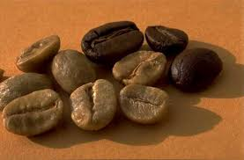
COFFEA CRUDA
Also known as coffea arabica
Family- rubiaceae
Common name- coffee
Habitat- Arabia.
Source- unroasted coffee beans.
Alkaloid- caffeine

Slide 3
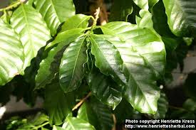
Preparation- mother tincture prepared from unroasted beans, and dilutions.
Class 1V preparation of drugs.
Part used dry seeds
Drug power- 1/10.

Slide 4
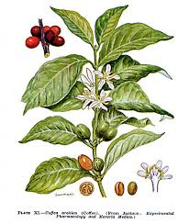
ABOUT THE PLANT..
Though it can grow up to 30 feet tall in the wild, the coffee plant is considered to be a bush or shrub.
It may grow with a single stem, but often it develops multiple stems by branching at the base.
The coffee plant is an evergreen, with a light gray bark and five-inch leaves that are dark green and glossy.

Slide 5
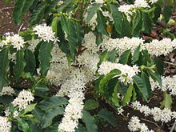
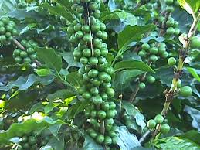
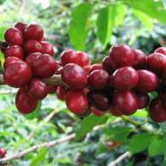
Coffee flowers are small, white and fragrant, helping to attract pollinating insects.
When the flowers fall off the plant, berries begin to develop in their place, ripening from a dark green to a bright crimson.

Slide 6
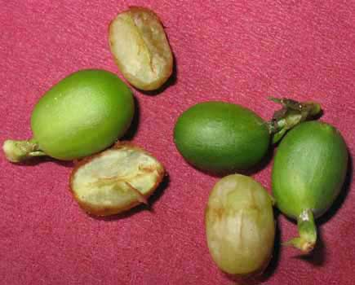
Two small green coffee beans, surrounded by skin and pulp, are found inside of the berry.
It takes 6 - 8 years of growth for a plant to be in full fruit production. Coffee plants can live to be 100 years old.

Slide 7
The leaves are wide, dark green and very glossy.
The blossoms of the coffee plant are small, white, star shaped flowers that smell very much like jasmine.
Grown in southeast asia, Africa, central and south America.
One coffee plant can produce berries for up to 25 years!
Each bean has its own taste & this can vary depending on the seasons or origin of the bean.
Depending on the altitude and the weather conditions, the period between the coffee plant blossoming & the berries being ready to harvest is around eight to nine months.
The plants often bloom for six to eight weeks, so it's quite common to find ripe & unripe berries on the same branch.

Slide 8
Habitat:
Coffee is a shade-loving plant that thrives in areas of high altitude, where there is a wet and dry season.
Originating in Ethiopia and Sudan, today more than two-thirds of the world’s coffee is grown in Latin America.
Coffee is the second most valuable commodity today in international commerce after oil; $2 billion worth is traded every year.
In every country in the world, people are drinking coffee.

Slide 9
The two economically important species of coffee are C. Arabica and C. Robusta.
Coffee was traditionally grown in the shade of trees. However, in the 1970s, coffee farmers began planting dwarf shrubs that produced higher yields and required no shade, resulting in the clearing of the shade trees.
But the dwarf shrubs require fertilizers, pesticides and constant care.
In addition, many species of migratory birds suffer as their winter tropical habitat is converted from forests to full-sun coffee farms.

Slide 10
STORY OF COFFEE
Legend has it that the energizing effects of coffee were first discovered by a goat.
Thousands of years ago in what is now Ethiopia, an Abyssinian herder noticed that, after his goats ate the bright red berries of the coffee plant, the animals became quite energetic.
He showed his discovery to some monks at a nearby monastery, who then brewed the berries into a beverage to keep them awake during evening prayers.
Thus, the first cups of coffee were born.
From Ethiopia, coffee spread across Arabia, and eventually found its way into cups around the world.

Slide 11
PHYSIOLOGICAL ACTION
This agent used as a beverage habitually and excessively produces indigestion with gastric acidity, vertigo, headache, cardiac irritabilityand despondency.
Poisonous doses produce delirium, partial loss of consciousness, slow irregular pulse, coldness, with a clammy perspiration, subnormal temperature, cramps, tremors, increased urine and diminished vision.
Employed as a stimulant to antidote the effects of narcotics.

Slide 12
HARMFUL EFFECTS
When restlessness or insomnia are caused by too much coffee consumption, however, they do not perform as a sleep aid.
It also is not a good idea for elderly people to regularly use this treatment.
Just like roasted and brewed coffee, it might increase the production of uric acid. This type of acid is known to contribute to arthritis symptoms and to hurt the kidneys.
Its use should be monitored carefully to decrease the likelihood of over-consumption.

Slide 13
USES
Coffea cruda is primarily used as a homeopathic remedy because it is believed to stimulate the organs while calming the nervous system.
It might also have broader uses in protecting food crops.
In whichever way the beans are used, they are highly regarded for their natural properties.
Whether roasted or unroasted, however, the caffeine contained in the coffee bean might cause addiction in some people and should, therefore, be used sparingly.

Slide 14
Just as coffee winds up the nerves, Coffea Cruda unwinds them, easing many stress-related symptoms as it goes – including hypersensitivity, nervous piercing headaches, and of course, sleeplessness due to an overactive mind, excitement, caffeine or coffee.
Whether a natural inclination or one induced by excessive stress, Coffea is most helpful when every pain is too painful (especially toothaches) and every nerve too nervous.

Slide 15
HOMOEOPATHICALLY….
Sleep & Insomnia:
Coffea is the remedy for insomnia from racing thoughts or for waking at the slightest noise.
The mind is usually excited, and thoughts are racing.
The remedy is very helpful for those who have worked very late, and are unable to sleep from too many thoughts.
It is also indicated for insomnia or other bad effects from joy, surprise or grief.

Slide 16
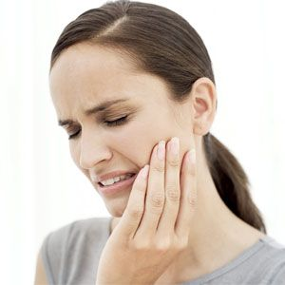
Hypersensitivity & Nervous System:
The nervous system as a whole is affected in Coffea, both within the mind state (oversensitivity, insomnia) and nerves (tooth-aches, headaches).
It is helpful for people with an over-stimulated nervous system, who react strongly to noise, touch or any of the senses.
It is also used for nervousness, hyper excitability, extreme sensitivity to pain and noise and overly sensitive skin.
Coffea can help with nervousness from drinking too much coffee, or from general ailments after the abuse of coffee (in acute situations).

Slide 17
Tooth Aches:
Coffea is also useful in toothaches.
Toothache is relieved by holding ice water in mouth but returns as soon as water becomes warm.

Slide 18
Headaches:
Coffea is well indicated in headache and neuralgia.
It is useful for extreme head pain or migraines made worse from any type of noise or music.
It is used for headache from mental exertion, talking, thinking and sudden emotions.
It can feel as if a nail is driven into the brain, the brain is torn to pieces or as if the head would burst and fly to pieces if he moves.
Coffea is also indicated in facial neuralgia of old coffee drinkers. Pains are unbearable driving the patient to despair.
Pain is worse by motion, afternoon and at night and better by pressure.

Slide 19
BLACK LETTER SYMPTOMS
Unusual activity of mind and body.
Full of ideas; quick to act,no sleep on this account.
Mental excitability.
Sleeplessness on account of excessive mental and physical excitement.
Fright from sudden pleasant surprises.
Pains seem insupportable, driving to despair.
Affections after sudden emotions, particularly pleasant surprises.

Slide 20
All the senses more acute, reads fine print easier, particularly an increased perception of slight passive motions.
Threatening of apoplexy; over-excited, talkative, full of fear, pangs of conscience. aversion to open air, sleepless, convulsive grinding of teeth.
One-sided headache, as from a nail driven into head (Thuja); worse in open air.
Neuralgic toothache entirely relieved by holding cold water in the mouth, returning as this becomes warm.
During labour or after -pains, extreme fear of death.
Great agitation and restlessness.
Affections after sudden emotions, especially pleasant surprises.
Would like to rub or scratch the part, but it is too sensitive.
Bad effects from wine or liquor drinking.
Thirst at night wakes him during, sweat, infrequent during heat; almost constant thirst after heat and during sweat.
As to the curious symptom: toothache relieved while cold water is held in mouth, and returning as this becomes warm. We have seen this more than once. And Coffea has promptly cured.

Slide 21
THANK YOU..

